Slide 1

Iot-Based medicine ASSISTIVE system FOR PATIENT
TIRUMALA ENGINEERING COLLEGE
DEPARTMENT OF ELECTRONICS AND COMMUNICATION ENGINEERING
ACADEMIC YEAR : 2021 – 2025
Project Members: Name of the Project Guide Head of the Department
P. RAMARAO (21NE1A04D5)
P. NEELIFA (21NE1A04E5)
P. MANOJ KUMAR (21NE1A04J2)
P. LEELA KRISHNA (21NE1A04D2)
Mr. G. Mallikarjuna Rao M. Tech
Associate Professor
Mr. T. Jagadeesh M.Tech, M.S, (Ph.D.)
Associate Professor

Slide 2



Contents
Introduction
Literature Survey
Key Findings
Problem Statement
Proposed Methodology
Expected Result
Summary
References

Slide 3
INTRODUCTION
In the current generation it is quite common to see people both young and old who are on medication due to some illness, for cosmetic purpose or who are required to take supplements due to some defects. If missing or delaying the medicines it can leads to severe health complications.
But it’s quite common for one to forget to take medication due to their hectic schedule and this is especially true in the case of the elderly who tend to forget things due to old age. To address this issue, we propose an IoT-based Medicine Assistive System for patients.
The Internet of Things (IoT) offers diverse solutions to address key challenges in healthcare systems and it is becoming more focused on patients and their needs.
As this Medicine Assistive System ensures timely medication reminders and proper intake tracking.

Slide 4
BLOCK DIAGRAM
POWER SUPPLY
NODE MCU
READ SWITCH -1
LCD
READ SWITCH -2
BUZZER
WIFI
LDR 1
DC MOTORS (L293D)
LDR 2
SPEAKER
FIG 1: BLOCK DIAGRAM

Slide 5
While the NODE MCU is ON and system is turned on it takes data from the patient and gives alert of the medicine to be taken as per patient requirement.
The medicine box proposed will have a knob through which either the patient or the guardian can set the time and then at the corresponding time an alarm sound will be on as well as an audio message will be heard .
The motors are driven by the L293D driver module and used to open and close the medicine box.
LDR sensor usually detects the light, this activates when any one of the medicine box is activated and it is used to sense whether the patient has taken medicine or not.
This system enhances medication observance and contributes to better health management for both children and adults.

Slide 6
LITERATURE SURVEY
S. No | Title | Author(s) | Year | Key Finding | Publication
1 | IoT-based Assistive System for Medication Compliance | N. Ahmed, L. Zhou | 2018 | The study proposed an assistive IoT system to improve medication compliance by integrating real-time reminders, compliance tracking, and wearable health monitoring devices. It helps patients adhere to prescriptions while allowing remote monitoring by caregivers | Journal of Medical Systems
2 | Smart Medicine Dispenser Using IoT | A. Kumar, P. Sharma, R. Singh | 2019 | The study proposed a smart medicine dispenser integrated with IoT technology to track and notify patients about their medicine schedules. The system includes a mobile app for reminders and real-time data logging to monitor adherence. | International Journal of Emerging Technologies in Engineering Research (IJETER)

Slide 7
3 | IoT-Based Smart Medicine Reminder with Patient Monitoring | H. Raj, V. Mehta, S. Kumar | 2020 | This study proposed a system that combines medicine reminders with basic patient health monitoring. It includes features such as scheduled alarms, heart rate monitoring, and caregiver notifications in case of missed doses. The system is affordable and scalable for widespread use. | International Journal of Emerging Technologies in Engineering Research (IJETER)
4 | IoT-Enabled Medication Reminder System for Elderly People | S. Patel, M. Desai | 2021 | The proposed system improves medication adherence among elderly individuals by using LED indicators and IoT connectivity. The system also provides caregivers with real-time updates through a web application. | IEEE Internet of Things Journal
5 | A Smart Pill Box with IoT Integration | K. Tan, Y. Li | 2022 | The system uses a smart pillbox integrated with IoT to dispense medication on time. It employs cloud storage for medical records and can be integrated with healthcare systems to track patient adherence. | Elsevier Computers in Biology and Medicine

Slide 8
Key findings
The system provides voice reminders and buzzer alerts at the scheduled time to ensure that patient is reminded about their medication. This dual-alert mechanism enhances accessibility for patients with hearing or visual impairments.
If the patient misses their dose, the system automatically sends notifications and report it to the designated patient or caretaker.

Slide 9
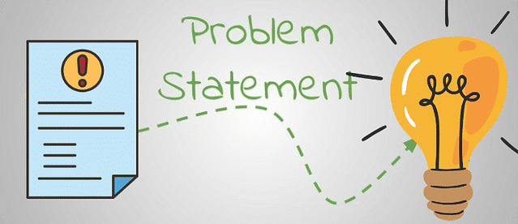
PROBLEM STATEMENT
Forgetting medication on time and difficulty for use, especially for elderly or illiterate patients. Lack of awareness about missed doses further increases health risks. Additionally, the high cost of assistive systems limits accessibility for many in need.

Slide 10
PROPOSED METHODOLOGY
START
Module ON
Connect to Wi-Fi
Connect to server
Magnetic switch 1 ON
yes
Magnetic switch 2 ON
yes
Motor 1 ON (Box 1 Open)
Motor 2 ON (Box 2 Open)
LDR Sensor Check
LDR Sensor Check
Timer Start
Timer Start
yes
Sensor Detect
Sensor Detect
no
no
no
Timer
1 min
Timer
1 min
yes
yes
Update to Server
Update to Server
Door Close
Door Close
FIG 2: Implementation

Slide 11
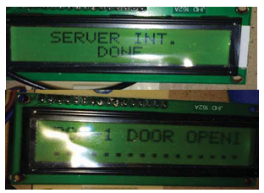
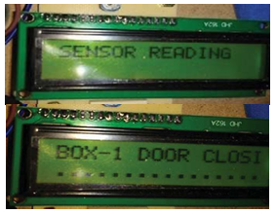
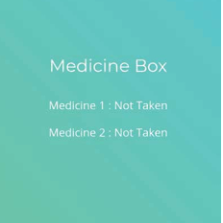
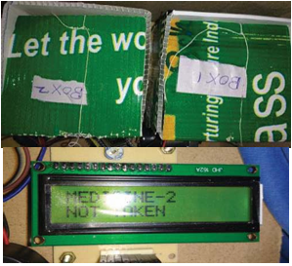
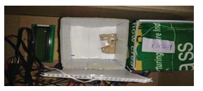
EXPECTED RESULT
FIG 5:Closing operation of box
FIG 3: Establishment of connection to network
FIG 7:Status Indication of Medication
FIG 4: Medicine Box lid open and indication on LCD
FIG 6:Indication- Medicine not taken

Slide 12
SUMMARY
The Medicine Assistive System is an innovative IoT-based solution designed to improve medication compliance, particularly for elderly and memory-impaired patients.
It features a dual-alert mechanism with voice reminders and buzzer alerts to notify users about their scheduled doses.
In case of missed doses, the system sends real-time notifications to caretakers, ensuring timely intervention and reducing health risks.
The IoT integration enables seamless synchronization, dose tracking, and remote monitoring. With its user-friendly interface and robust functionality, the system significantly enhances medication management and supports better healthcare outcomes.

Slide 13
REFERENCES
[1]. A. Kumar, P. Sharma, R. Singh, "Smart Medicine Dispenser Using IoT," International Journal Of Emerging Technologies In Engineering Research (IJETER), 2019.
[2]. S. Patel, M. Desai, "IoT-enabled Medication Reminder System For Elderly People," IEEE Internet Of Things Journal, 2021.
[3]. R. K. Gupta, T. Chakraborty, "A Novel IoT-based Health Monitoring And Medicine Reminder System," Springer Lecture Notes In Electrical Engineering, 2020.
[4]. N. Ahmed, L. Zhou, "IoT-based Assistive System For Medication Compliance," Journal Of Medical Systems, 2018.
[5]. K. Tan, Y. Li, "A Smart Pill Box With IoT Integration," Elsevier Computers In Biology And Medicine, 2022.
[6]. H. Raj, V. Mehta, S. Kumar, "IoT-based Smart Medicine Reminder With Patient Monitoring," International Journal Of Scientific And Engineering Research (IJSER), 2020.

Slide 14
[7]. P.A.Harsha Vardhini, M.Ravinder, P.Srikanth Reddy, M.Supraja, “Power Optimized Arduino Baggage Tracking
System With Finger Print Authentication”, Journal Of Applied Science And Computations J-ASC, Pp.3655- 3660,Vol.6, Issue 4. April. 2019.
[8]. P.A. Harsha Vardhini "Efficient Irrigation System Powered By Solar Panel Setup With Tracking Mechanism",
International Journal Of Emerging Technologies And Innovative Research, Vol.4, Issue 3, Pp. 238-241, March 2017.
[9]. P.A.Harsha Vardhini, M.Ravinder, P.Srikanth, M.Supraja, “ Iot Based Wireless Data Printing Using Raspberry Pi”,Journal Of Advanced Research In Dynamical And Control Systems, Pp.21412145, Vol. 11, Spl. Issue.4, 2019.
[10]. Tushara, D. Bindu And P. A. Harsha Vardhini. “Wireless Vehicle Alert And Collision Prevention System Design
Using Atmel Microcontroller.” 2016 International Conference On Electrical, Electronics, And Optimization
Techniques (ICEEOT) (2016): 27842787.

Slide 15
THANK YOU

